Slide 1

FUZZY CONTROL SYSTEM FOR BRAKE SYSTEM
SINHGAD COLLEGE OF ENGINEERING
DEPARTMENT OF COMPUTER ENGINEERING
PRESENTED BY
B150234282 – PRATIK KARAD
B150234291 – KINJAL PAGAR
B150234292 – VINIT KORADE

Slide 2
CONTENTS
Introduction
What is Fuzzy Logic?
Fuzzy Interface System
Fuzzy Control System for Brake System
Developing Fuzzy Control System
Results
Conclusion
Reference

Slide 3
INTRODUCTION
Fuzzy logic is an approach to computing based on “degrees of truth”.
Fuzzy logic is the powerful mathematical tool that can deal with imprecise, incomplete and uncertain information present in complex real world problems.
Fuzzy systems deals with incomplete or vague information.
A Fuzzy Controller System (FCS) is developed for automatic Brake controlling.
Inputs to the FCS are speed and distance between vehicle & object.
The consequences provided by system are Brake Pressure.

Slide 4
WHAT IS FUZZY LOGIC?
Fuzzy
Fuzzy – “not clear, distinct, or precise; blurred”
Fuzzy logic
A form of knowledge representation suitable for notions that cannot be defined precisely, but which depend upon their contexts.
A way to represent variation or imprecision in logic.
A way to make use of natural languagein logic.
Approximate reasoning.

Slide 5
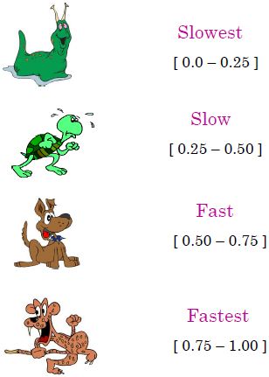
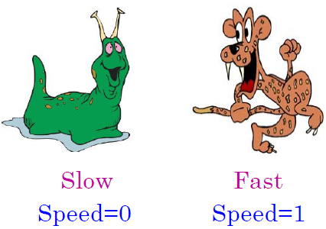
CRISP OUTPUT VS. FUZZY OUTPUT
Fig. Crisp Output
Fig. Fuzzy Output

Slide 6
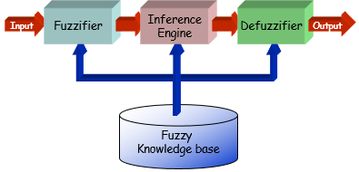
FUZZY INFERENCE SYSTEM
Fuzzy inference system is the key unit of a fuzzy logic system.
Fuzzy inference (reasoning) is the actual process of mapping from a given input to an output using fuzzy logic.

Slide 7
FUZZY INFERENCE SYSTEM
Fuzzifier
Converts the crisp input to a linguistic variable using the
Membership functions stored in the fuzzy knowledge base.
Fuzzy Knowledge Base
The rule base and the database are jointly referred to as the knowledge base.
A rule base containing a number of fuzzy IF–THEN rules.
a database which defines the membership functions of the fuzzy sets used in the fuzzy rules

Slide 8
FUZZY INFERENCE SYSTEM
Inference Engine
Using If-Then type fuzzy rules converts the fuzzy input to the fuzzy output.
Defuzzifier
Converts the fuzzy output of the inference engine to crisp using membership functions analogous to the ones used by the fuzzifier.

Slide 9

PROBLEM STATEMENT
To develop a Fuzzy Control System for Self-Controlling Brake system which adjusts the brake pressure for the vehicle dependent on the vehicle speed and distance between object and the vehicle.

Slide 10

FUZZY CONTROL SYSTEM FOR BRAKE SYSTEM
The user of vehicle is of elegant class so designing a controller to automate the brake system must be accurate with reducing the risk factor and the comfort factor.
This system uses fuzzy logic to maintain the safe drive and the distance close to the risky object.
The developed control system extremely reduces the use of manual brakes and human endeavor and maintains the reduction of the risk of accident from risky object in way to road.

Slide 11
SYSTEM ARCHITECTURE
Antecedents
Antecedent (input/sensor) variable for a fuzzy control system.
In our system antecedents are vehicle speed & distance between vehicle object.
These antecedents are defined with their membership value ranges.
The membership value is calculated using membership functions.
Knowledge Base
The rule base and the database are jointly referred to as the knowledge base.
Eg.: if speed is high && distance is minimum then pressure is high
Consequents
Consequent (output/control) variable for a fuzzy control system.
Consequents of this system are:-
Brake Pressure

Slide 12
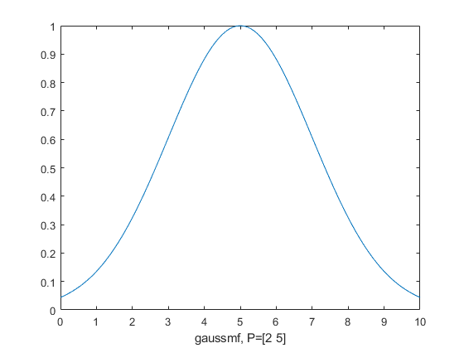
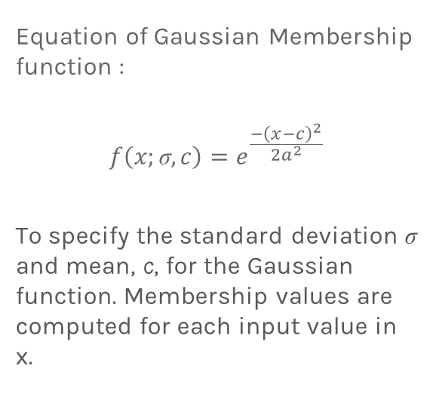
GAUSSIAN MEMBERSHIP FUNCTION
Equation of Gaussian Membership function :
$$f\left(x;\text{σ},c\right)=e^{\frac{{−\left(x−c\right)}^{2}}{{2a}^{2}}}$$
To specify the standard deviation $\text{σ}$ and mean, c, for the Gaussian function. Membership values are computed for each input value in x.

Slide 13
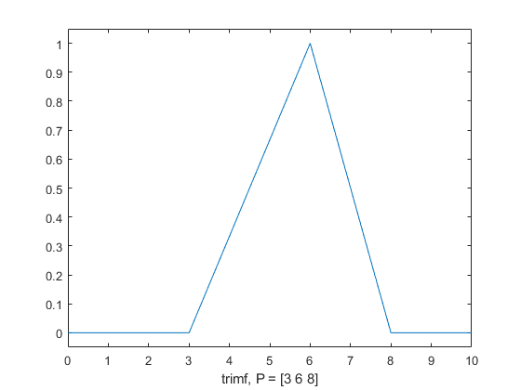
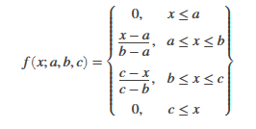
TRIANGULAR MEMBERSHIP FUNCTION
Equation of triangular membership function:

Slide 14
DEVELOPING FUZZY CONTROL SYSTEM
In Python, library for fuzzy systems is available i.e. scikit-fuzzy imported as skfuzzy.
Following are the steps for developing FCS:-
Several number of rules are defined in knowledge base to develop the FCS.
All the rules defined in the knowledge base are used to train the Control System.
Then the trained system is passed to Control System Simulation which is used to calculate the results from a Control System.
The next step is to provide the inputs (antecedents) and pass it to their appropriate developed control systems.
Finally the fuzzy output is provided by the system which is brake pressure.

Slide 15
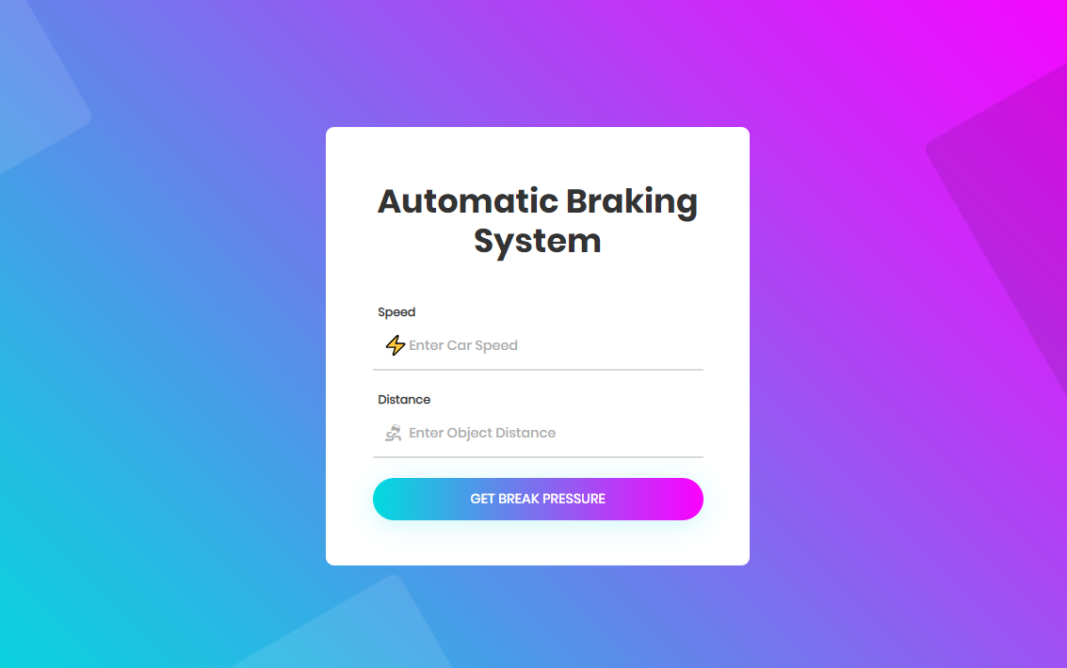
PROJECT GUI
User have to enter vehicle speed and distance from object .

Slide 16
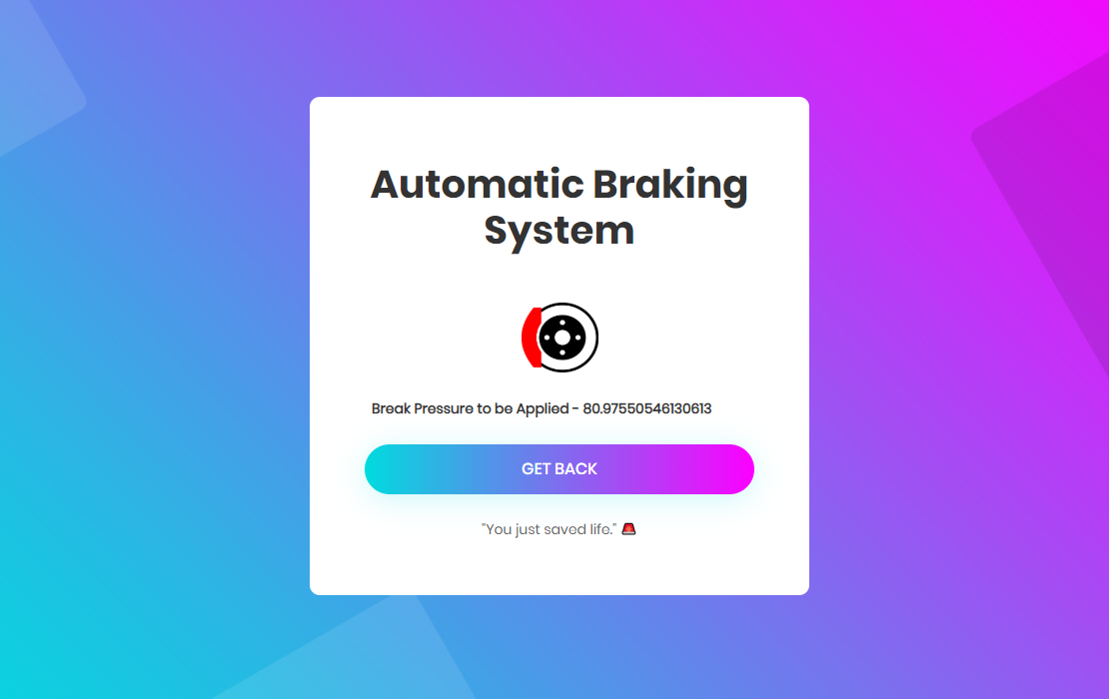
RESULT
User will get brake pressure to be applied.

Slide 17
REFERENCES
https://www.tutorialspoint.com/fuzzy_logic/fuzzy_logic_introduction.htm
https://searchenterpriseai.techtarget.com/definition/fuzzy-logic
https://www.geeksforgeeks.org/fuzzy-logic-introduction

Slide 18
THANK YOU!
Any questions?
You can contact us at vinit.korade@gmail.com
kpagar20.kp@gmail.com
pratikkarad.karad27@gmail.com

